Slide 1
Correlations w/ VA AUC and intercept
Adam Shah

Slide 2
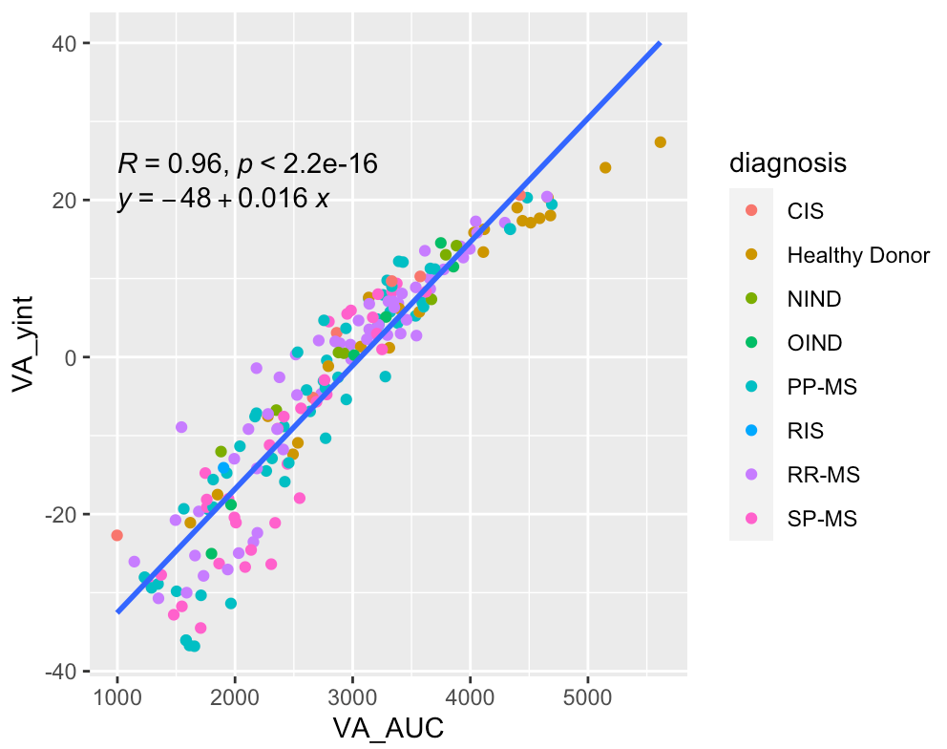
Area under curve and y-intercept
Highly correlated, almost looks like a quadratic relationship?

Slide 3
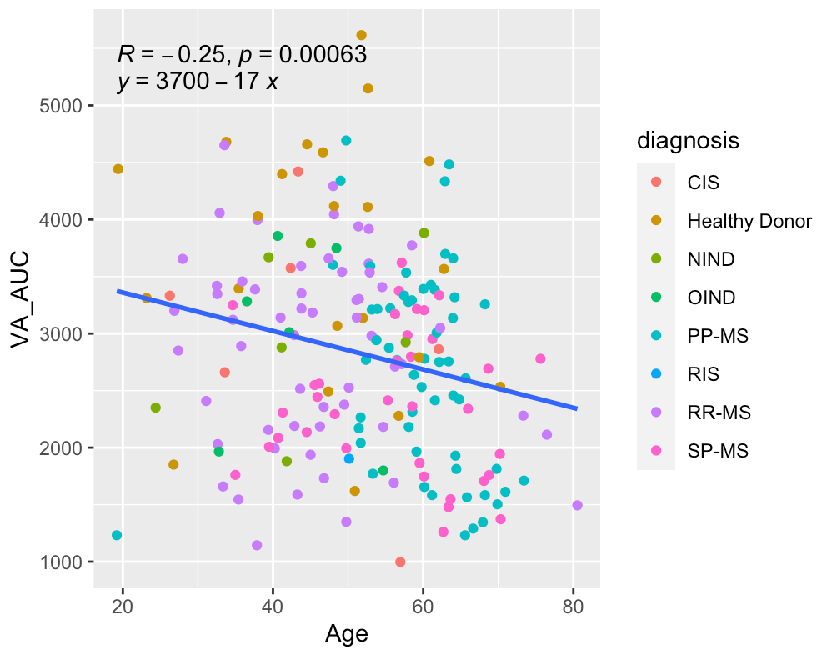
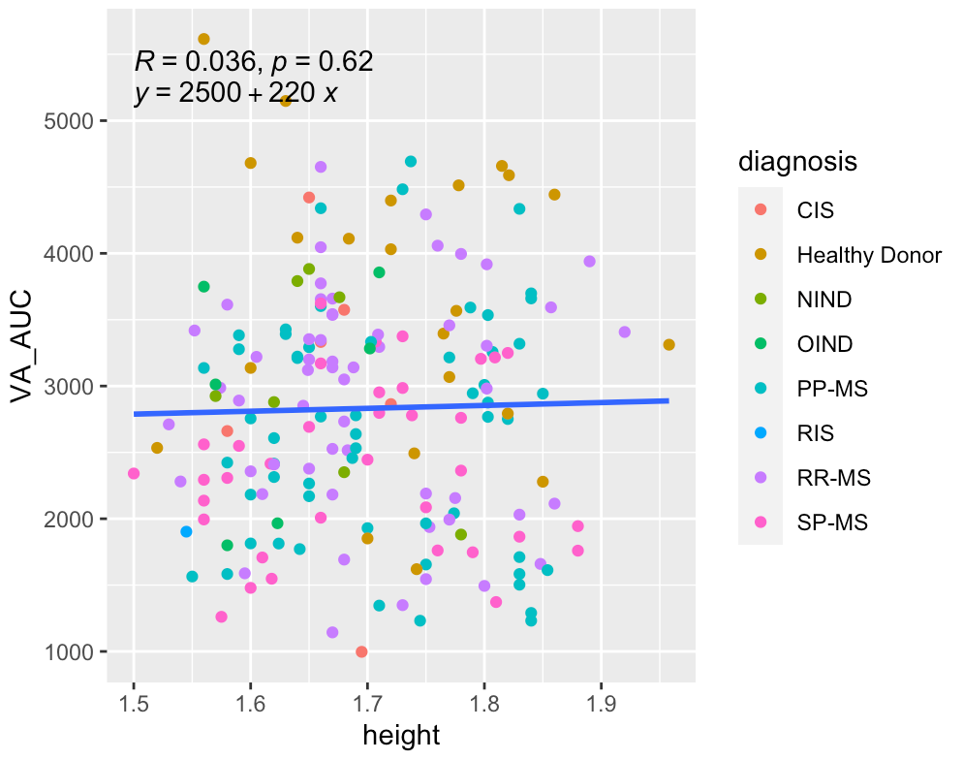
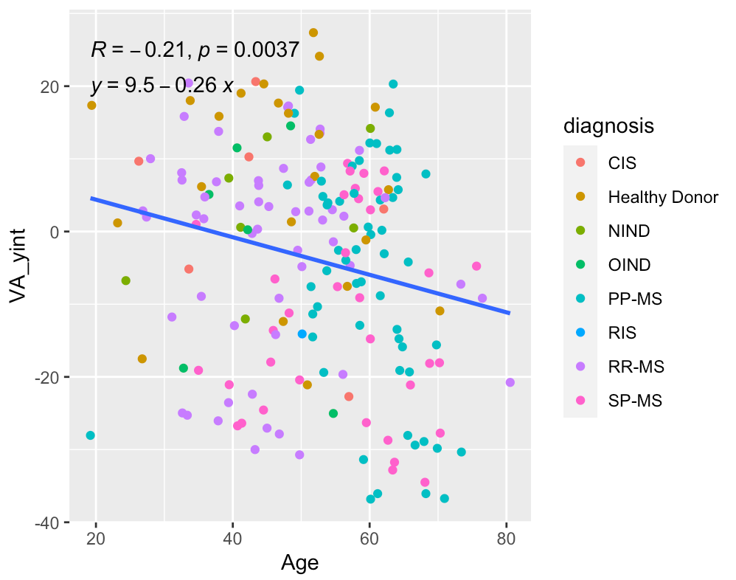
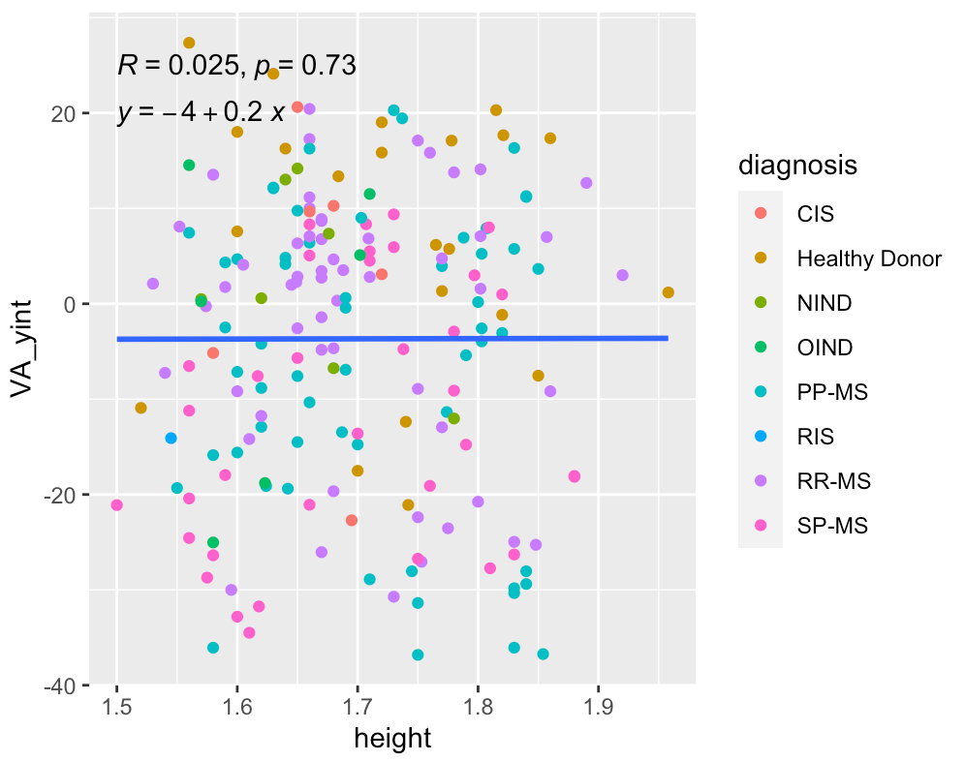
Relationships w/ age and height

Slide 4
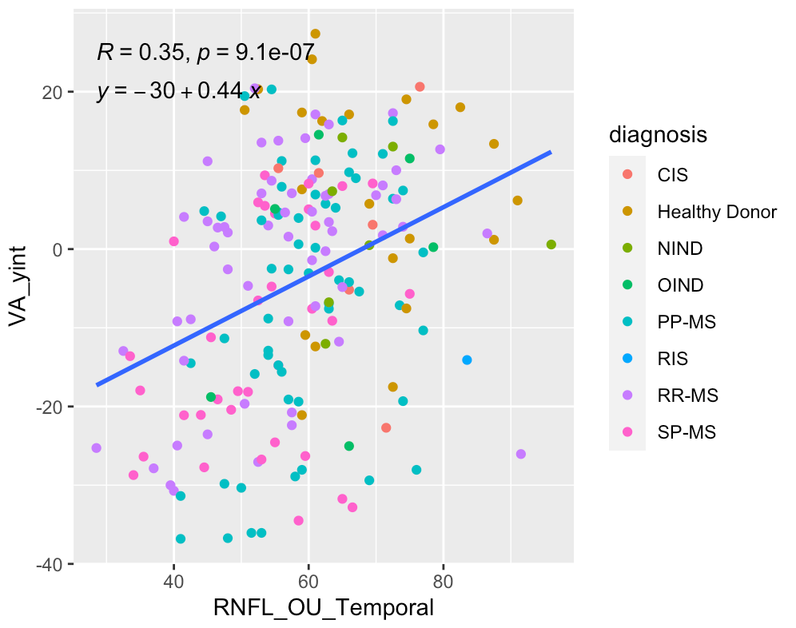
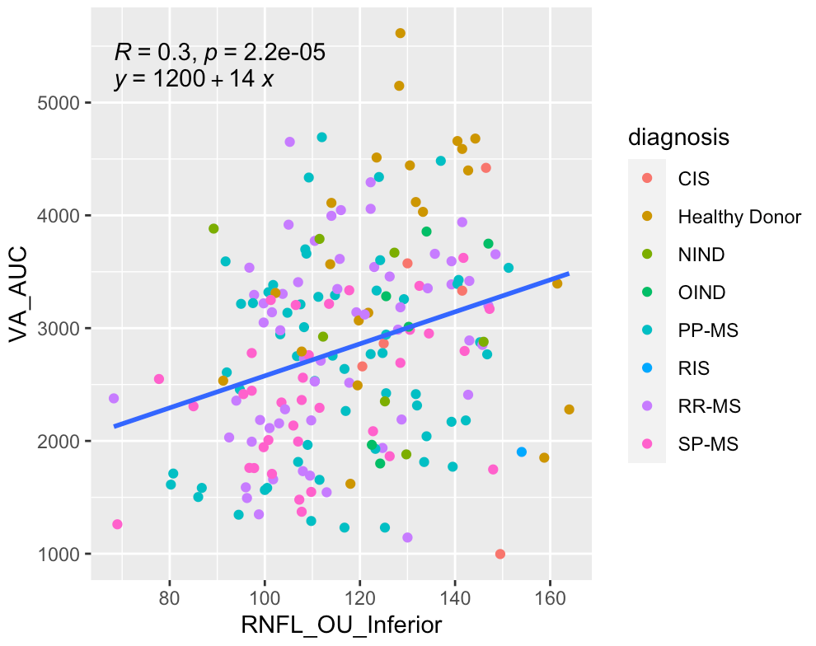
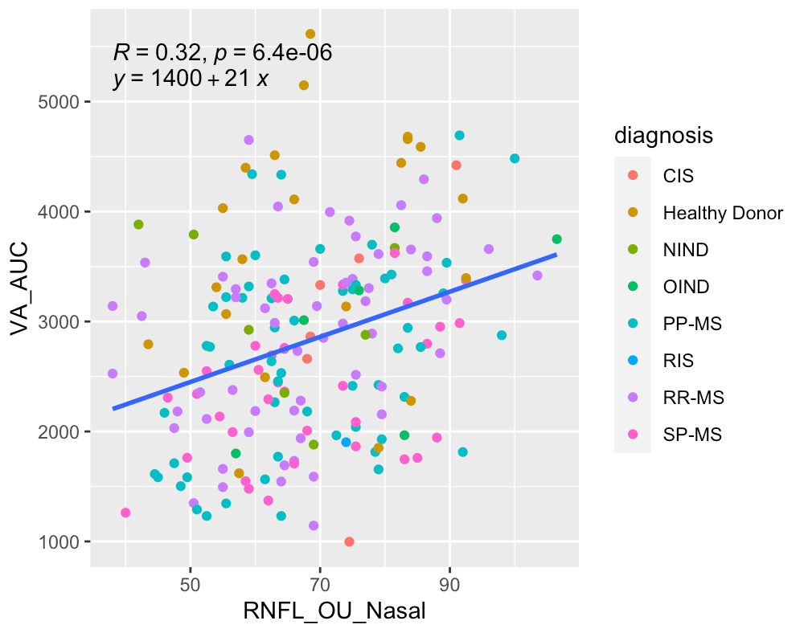
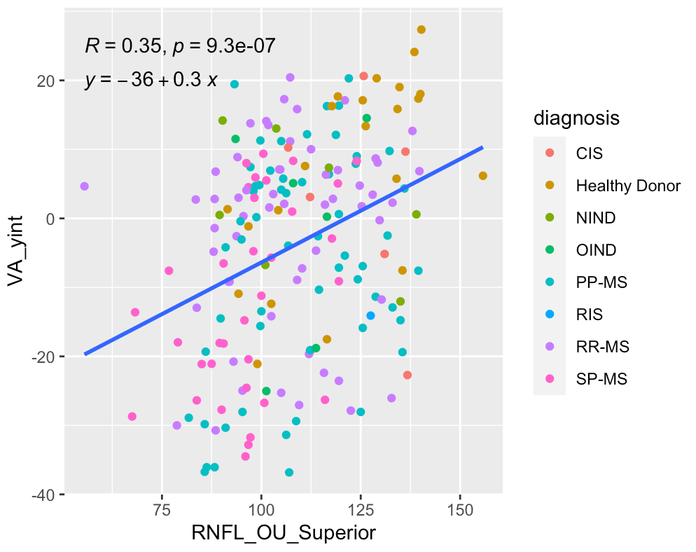
Relationships w/ RNFL

Slide 5
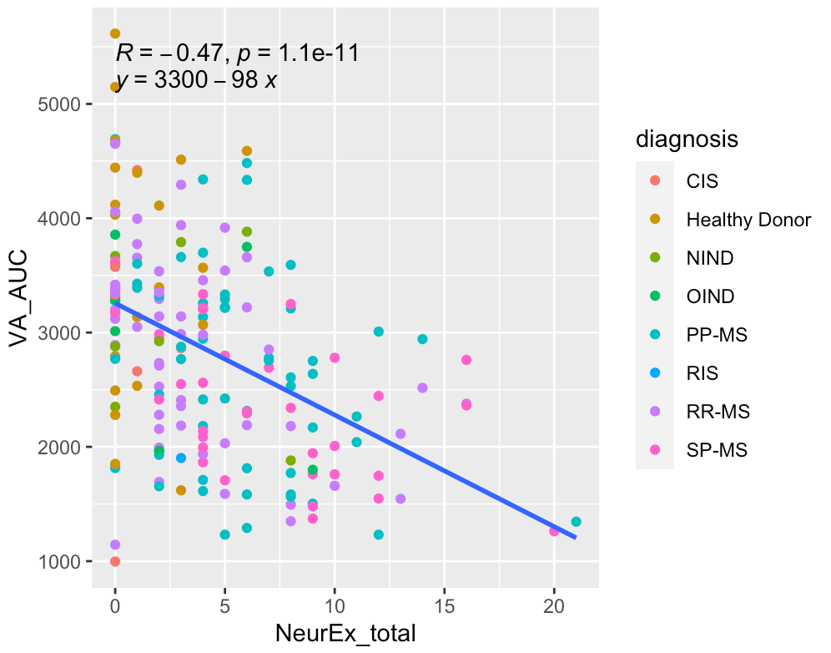
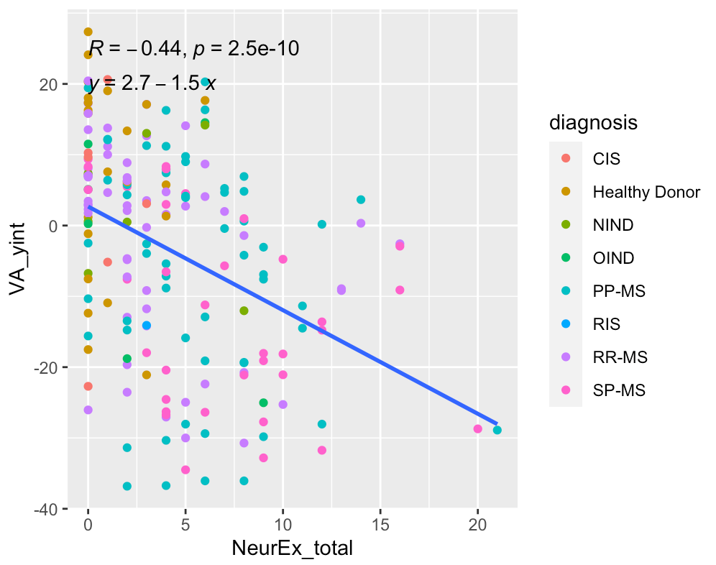
Relationships w/ NeurEx
*Both also showed significant negative correlations with all individual NeurEx panels

Slide 6
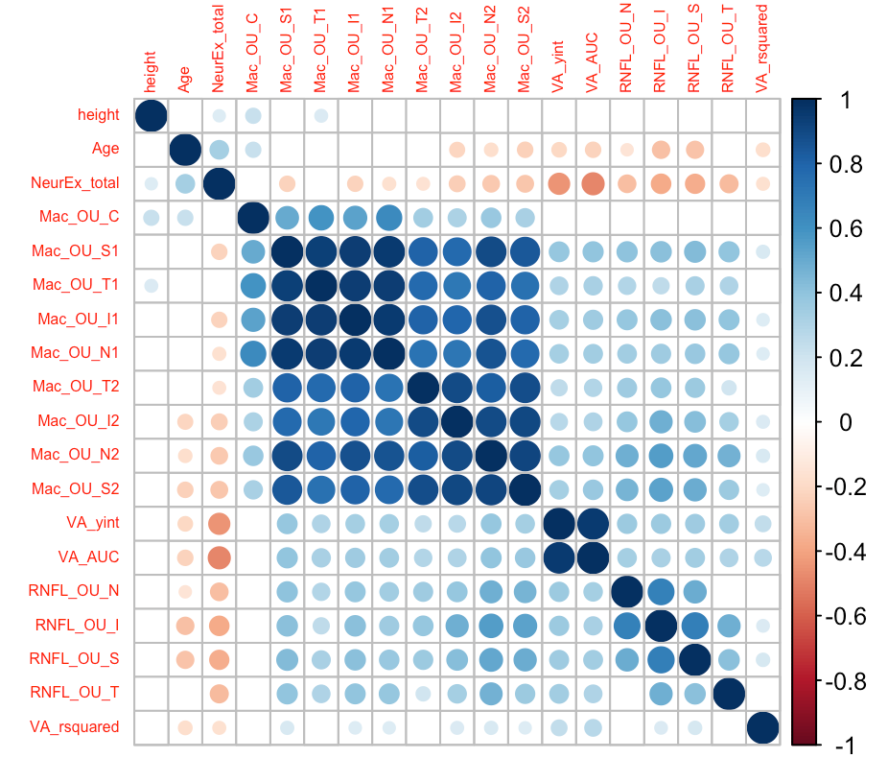
Spearman correlation matrix
*blanks represent p-value > 0.05

